Slide 1
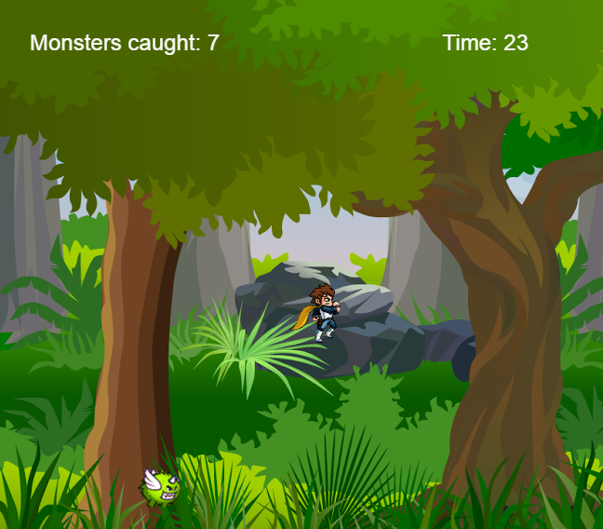
Monster Hunt Game
The story of the game Monster Hunt:
∞
A hero must capture 100 monsters for minimal time. Then the game is over.

Slide 2
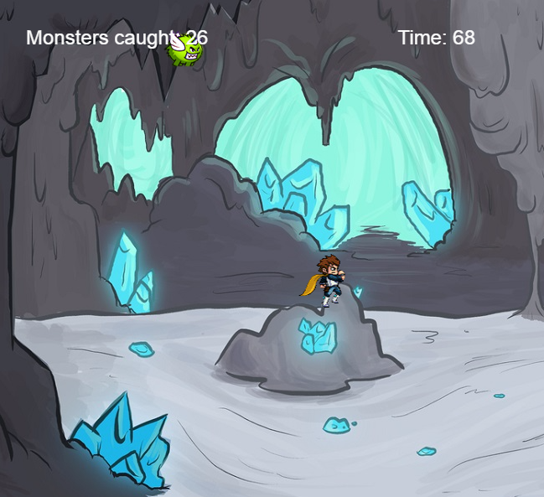
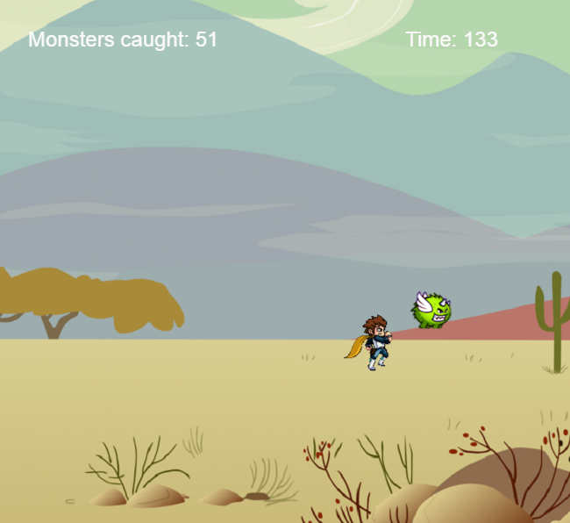
The game has 3 levels, depending on the number of captured monsters.

Slide 3
The background of the game is added a melody, as well as other sound capture the monster.
Now is the time for demonstration ☺

Slide 4
Team Members: Lubomir Vulev, Martin Georgiev and Milena Ancheva Thank you for your attention!

